Slide 1

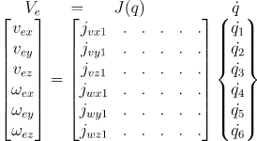
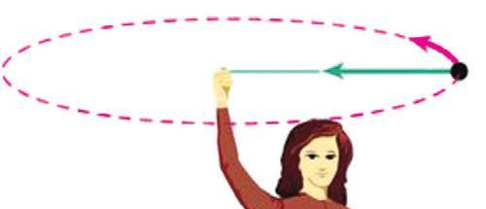

Derivation of Angular Components of Jacobian Matrix
Picture taken from Robotics and Control by Nagrath and Mittal
Angular velocity of the stone is imparted from the finger.
Angular velocity is a vector having direction and amplitude.
Direction is the direction of the (joint) axis and magnitude is a scalar in degrees/sec.

Slide 2
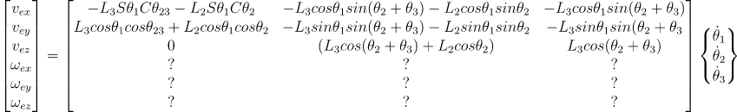
Picture taken from Robotics and Control by Nagrath and Mittal

Slide 3


This is the direction of the 2nd joint axis, i.e. Z₁. Write Z₁ w.r.t base frame (frame 0). 3rd Column of ⁰T₁ is Z₁.
This is the direction of the 3rd joint axis, i.e. Z₂. Write Z₂ w.r.t base frame (frame 0). 3rd Column of ⁰T₂ is Z₂.
This is the direction of the 1st joint axis, i.e. Z₀.

Slide 4
